Slide 1

CODE DETECTION USING MATLAB
PREPARED BY- 1.
2.
3.
4.

Slide 2
OBJECTIVES
Need of Line Coding
Introduction of Line Coding
Properties of Line Coding
Types of Line Coding
Advantages and Disadvantages
Power Spectral Density
PSD of Line Coding
Comparison of Line Coding
Shannon-Fano Coding

Slide 3
As, the title describes the project – CODE DETECTION USING MATLAB Let’s get the basics right..!
What is “a CODE” in terms of Digital electronics ?
Digital Line Coding is a special coding system chosen to allow transmission
to take place in a communications system. The chosen code or pattern of
voltage used to represent binary digits on a transmission medium is called
line encoding.
CODE DETECTION USING MATLAB

Slide 4
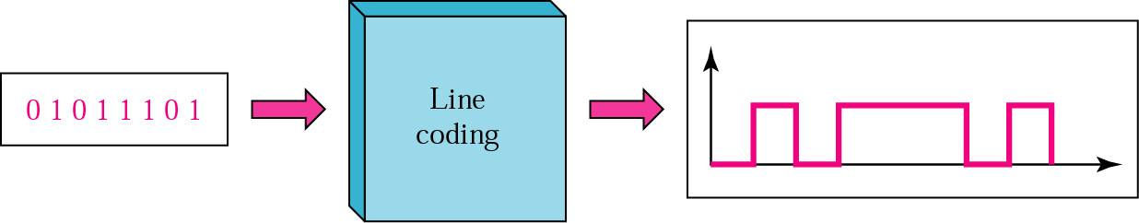
STRUCTURE OF LINE CODING
Binary Data: Pulses
Line Coding: A pair of pulses to represent symbols 1 and 0
CODE DETECTION USING MATLAB

Slide 5
PROPERTIES OF LINE CODING
Transmission Bandwidth: as small as possible
Power Efficiency: As small as possible for given BW and
probability of error
Error Detection and Correction capability: Ex: Bipolar
Favourable power spectral density: dc=0
Adequate timing content: Extract timing from pulses
Transparency: Prevent long strings of 0s or 1s
CODE DETECTION USING MATLAB

Slide 6
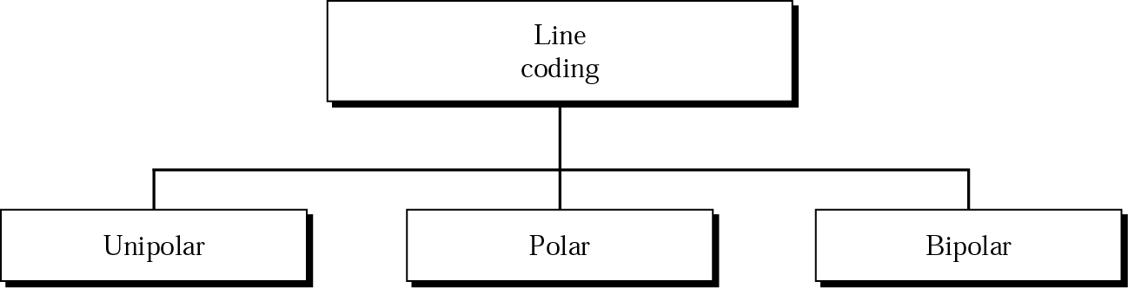
TYPES OF LINE CODING
CODE DETECTION USING MATLAB

Slide 7
UNIPOLAR SIGNALLING
On-Off keying i.e. OOK
Pulse 0: Absence of pulse
Pulse1 : Presence of pulse
There are two common variations of unipolar signalling:
Non-Return to Zero (NRZ)
Return to Zero (RZ)
CODE DETECTION USING MATLAB

Slide 8
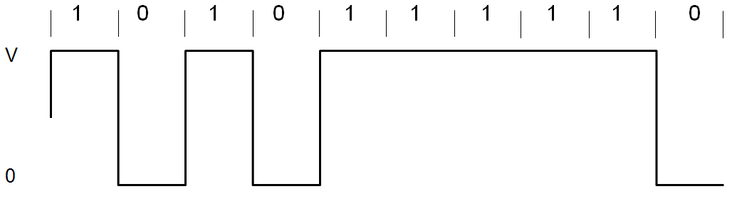
UNIPOLAR NON-RETURN TO ZERO (NRZ)
Duration of the MARK pulse (Ƭ ) is equal to the duration (To) of the symbol slot.
CODE DETECTION USING MATLAB

Slide 9
UNIPOLAR SIGNALLING NRZ
Advantages:
Simplicity in implementation
Doesn’t require a lot of bandwidth for transmission.
Disadvantages:
Presence of DC level (indicated by spectral line at 0 Hz).
Contains low frequency components. Causes “Signal Droop”
Does not have any error correction capability.
Does not posses any clocking component for ease of synchronisation.
Is not Transparent. Long string of zeros causes loss of synchronisation.
CODE DETECTION USING MATLAB

Slide 10
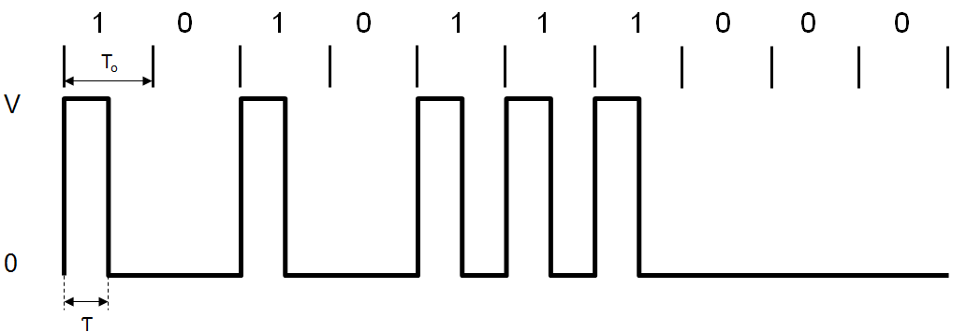
UNIPOLAR RETURN TO ZERO (RZ)
MARK pulse (Ƭ ) is less than the duration (To) of the symbol slot.
Fills only the first half of the time slot, returning to zero for the second half.
CODE DETECTION USING MATLAB

Slide 11
UNIPOLAR SIGNALLING RZ
Advantages:
Simplicity in implementation.
Presence of a spectral line at symbol rate which can be used as symbol timing
clock signal.
Disadvantages:
Presence of DC level (indicated by spectral line at 0 Hz).
Continuous part is non-zero at 0 Hz. Causes “Signal Droop”.
Does not have any error correction capability.
Occupies twice as much bandwidth as Unipolar NRZ.
Is not Transparent
CODE DETECTION USING MATLAB

Slide 12
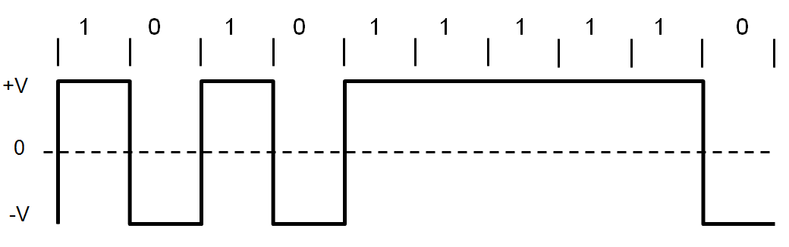
POLAR NON-RETURN TO ZERO (NRZ)
A binary 1 is represented by a pulse g1(t)
A binary 0 by the opposite (or antipodal) pulse g0(t) = -g1(t).
CODE DETECTION USING MATLAB

Slide 13
POLAR SIGNALLING NRZ
Advantages:
Simplicity in implementation.
No DC component.
Disadvantages:
Continuous part is non-zero at 0 Hz. Causes “Signal Droop”.
Does not have any error correction capability.
Does not posses any clocking component for ease of synchronisation.
Is not transparent.
CODE DETECTION USING MATLAB

Slide 14
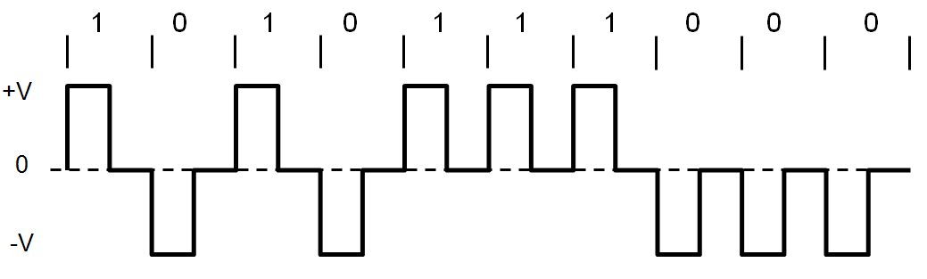
POLAR RETURN TO ZERO (RZ)
A binary 1: A pulse g1(t)
A binary 0: The opposite (or antipodal) pulse g0(t) = -g1(t).
Fills only the first half of the time slot, returning to zero for the second half.
CODE DETECTION USING MATLAB

Slide 15
POLAR SIGNALLING RZ
Advantages:
Simplicity in implementation.
No DC component.
Disadvantages:
Continuous part is non-zero at 0 Hz. Causes “Signal Droop”.
Does not have any error correction capability.
Occupies twice as much bandwidth as Polar NRZ.
CODE DETECTION USING MATLAB

Slide 16
BIPOLAR SIGNALLING
Alternate mark inversion (AMI)
Uses three voltage levels (+V, 0, -V)
0: Absence of a pulse
1: Alternating voltage levels of +V and –V
CODE DETECTION USING MATLAB

Slide 17
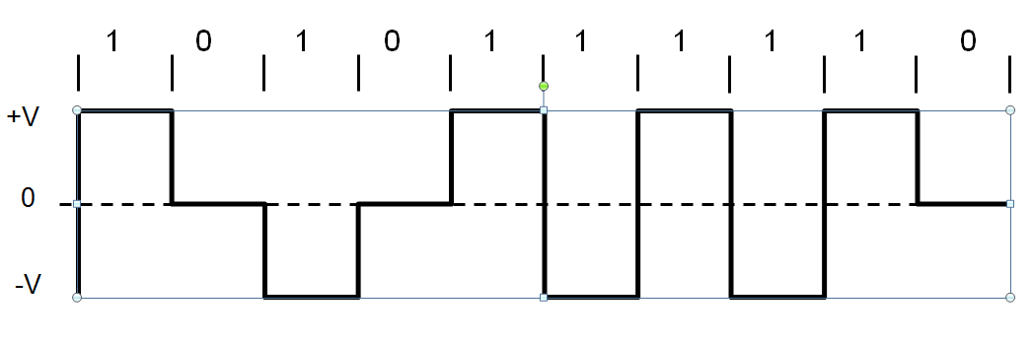
BIPOLAR NON-RETURN TO ZERO (NRZ)
CODE DETECTION USING MATLAB

Slide 18
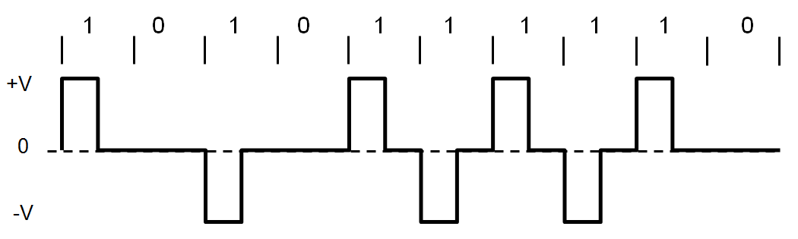
BIPOLAR RETURN TO ZERO (RZ)
CODE DETECTION USING MATLAB

Slide 19
BIPOLAR SIGNALLING
Advantages:
No DC component.
Occupies less bandwidth than unipolar and polar NRZ schemes.
Does not suffer from signal droop (suitable for transmission over AC coupled lines).
Possesses single error detection capability.
Disadvantages:
Does not posses any clocking component for ease of synchronisation.
Is not Transparent
CODE DETECTION USING MATLAB

Slide 20
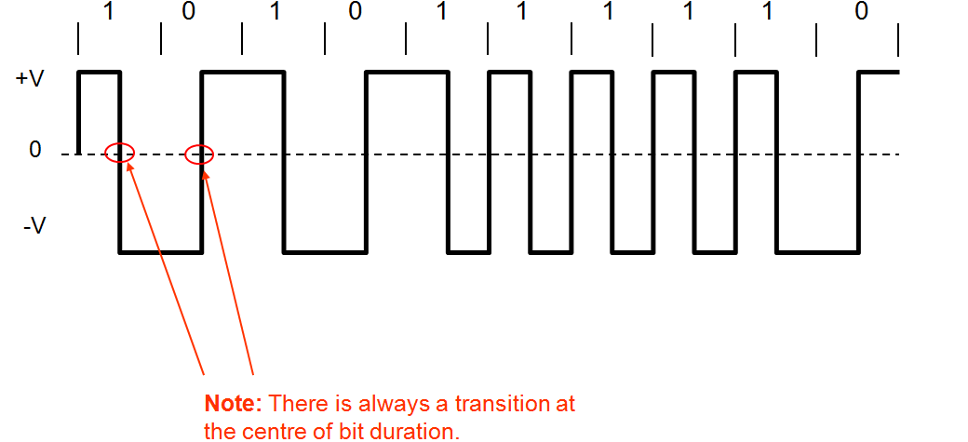
MANCHESTER SIGNALLING
The duration of the bit is divided into two halves
A ‘One’ is +ve in 1st half and -ve in 2nd half.
A ‘Zero’ is -ve in 1st half and +ve in 2nd half.
CODE DETECTION USING MATLAB

Slide 21
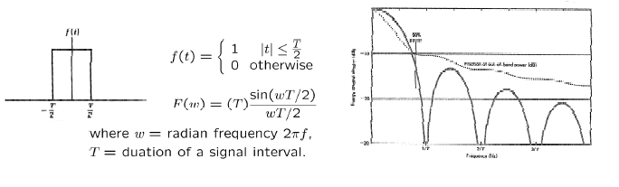
POWER SPECTRAL DENSITY
The function which gives distribution of power of a signal at various frequencies in frequency domain.
PSD is the Fourier Transform of autocorrelation
Rectangular pulse and its spectrum
CODE DETECTION USING MATLAB

Slide 22



POWER SPECTRAL DENSITY OF BIPOLAR SIGNAL
To calculate the PSD, we have
On the average, half of the are 0, and the remaining half are
either 1 or -1, with . Therefore,
CODE DETECTION USING MATLAB

Slide 23
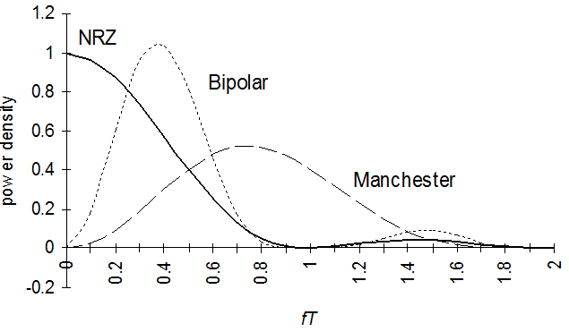
PSD OF LINE CODES
CODE DETECTION USING MATLAB

Slide 24
COMPARISON OF LINE CODES
Sr. No. | Parameters | Polar RZ | Polar NRZ | AMI | Manchester
1 | Transmission of DC component | YES | YES | NO | NO
2 | Signaling Rate | 1/Tb | 1/Tb | 1/Tb | 1/Tb
3 | Noise Immunity | LOW | LOW | HIGH | HIGH
4 | Synchronizing Capability | Poor | Poor | Very Good | Very Good
5 | Bandwidth Required | 1/Tb | 1/2Tb | 1/2Tb | 1/Tb
6 | Crosstalk | HIGH | HIGH | LOW | LOW
CODE DETECTION USING MATLAB

Slide 25
SHANNON-FANO CODING IMPLEMENTATION
Arrange the character set in order of decreasing probability
While a probability class contains more than one symbol:
Divide the probability class in two
so that the probabilities in the two halves are as nearly as possible equal
Assign a '1' to the first probability class, and a '0' to the second
CODE DETECTION USING MATLAB

Slide 26
HUFFMAN CODING IMPLEMENTATION
Scan text to be compressed and tally occurrence of all characters.
Sort or prioritize characters based on number of occurrences in text.
Build Huffman code tree based on prioritized list.
Perform a traversal of tree to determine all code words.
Scan text again and create new file using the Huffman codes.
HUFFMAN CODING APPLICATION
Huffman coding is a technique used to compress files for transmission
Uses statistical coding
more frequently used symbols have shorter code words
Works well for text and fax transmissions
An application that uses several data structures
CODE DETECTION USING MATLAB

Slide 27
THANK YOU ☺
CODE DETECTION USING MATLAB

